Slide 1


Slide 2
Interprocess Communication
Inter-process communication (IPC) is a set of methods for the exchange of data among multiple threads in one or more processes.
Processes may be running on one or more computers connected by a network.
Operating systems provide facilities/resources for inter-process communications (IPC), such as message queues, semaphores, and shared memory.

Slide 3
Interprocess Communication Methods
Inter-process communication techniques can be divided into various types. These are:
1. Shared memory
2. Message Passing / Message Queue
3. Sockets
4. Pipes
5. FIFO (Named Pipes)

Slide 4
Interprocess Communication Methods
Shared memory: Shared memory is an efficient means of passing data between programs.
An area is created in memory by a process, which is accessible by another process.
Processes communicate by reading and writing to that memory space.
Message queues: By using this method, a developer can pass messages between messages via a single queue or a number of message queues. A system kernel manages this mechanism.

Slide 5
Interprocess Communication Methods
Sockets: We use this mechanism to communicate over a network, between a client and a server. This method facilitates a standard connection that is independent of the type of computer and the type of operating system used.
FIFO: A FIFO or 'first in, first out' is a one-way flow of data.
FIFOs are similar to pipes
FIFOs are identified in the file system with a name.
FIFOs are 'named pipes'.

Slide 6
Processes
Independent process cannot affect or be affected by the execution of another process
Cooperating process can affect or be affected by the execution of another process

Slide 7
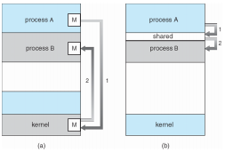
Interprocess Communication Methods
(a) Message passing (Indirect) (b) Shared Memory (Direct)

Slide 8
Shared Memory
Also known as Direct Communication
Processes must name each other explicitly:
send (P, message) – send a message to process P
receive(Q, message) – receive a message from process Q
Properties of communication link:
A link is associated with exactly one pair of communicating processes
Between each pair there exists exactly one link
The link may be unidirectional, but is usually bi-directional

Slide 9
Message Passing
Also known as In-direct Communication
Messages are directed and received from mailboxes (also referred to as ports)
Each mailbox has a unique id
Processes can communicate only if they share a mailbox
Properties of communication link
Link established only if processes share a common mailbox
A link may be associated with many processes
Link may be unidirectional or bi-directional

Slide 10
IPC: Message Passing
Operations
create a new mailbox
send and receive messages through mailbox
destroy a mailbox
Operations/ Primitives are defined as:
send(mailbox, message) – send message to mail box
receive(mailbox, message) – mailbox receives message.
send(A, message) – send a message to mailbox A
receive(A, message) – receive a message from mailbox A

Slide 11
IPC: Message Passing
Mailbox sharing
P1, P2, and P3 share mailbox A
P1, sends; P2 and P3 receive
Who gets the message?
Solutions:
  Allow a link to be associated with at most two processes
  Allow only one process at a time to execute a receive operation
  Allow the system to select arbitrarily the receiver. Sender is notified who the receiver was.

Slide 12
IPC: Message Passing
  Sending Process could be:
  Blocking: Sending process wait (I.e., block) for receiver
  Blocking: Slows down sender
  Non-blocking: Requires buffering between sender and receiver

Slide 13
IPC: Message Passing
If P and Q wish to communicate, they need to:
– establish a communication link between them
– exchange messages via send/receive
Implementation of communication link
– physical (e.g., shared memory, hardware bus)
– logical (e.g., logical properties/ programming)

Slide 14
IPC: Message Passing
Producer-Consumer Problem :Paradigm for cooperating processes
Producer process produces information that is consumed by a consumer process
– unbounded-buffer: places no practical limit on the size of the buffer
– bounded-buffer: assumes that there is a fixed buffer size

Slide 15
IPC: Message Passing Synchronization
• Message passing may be either:
Blocking
Non-blocking
1. Blocking is considered synchronous:
Blocking send: has the sender block until the message is received
Blocking receive: has the receiver block until a message is available

Slide 16
IPC: Message Passing Synchronization
2. Non-blocking is considered asynchronous:
Non-blocking send: has the sender send the message and continue
Non-blocking receive: has the receiver receive a valid message or null

Slide 17
IPC: Message Passing
Buffering
Queue of messages attached to the link;
It is implemented in one of three ways:
1. Zero capacity – zero messages
  Sender must wait for receiver
2. Bounded capacity – finite length of n messages
  Sender must wait if link full
3. Unbounded capacity – infinite length
  Sender never waits

Slide 18
Message Queues
The messages that pass through the queue have two components:
one that describes the message (header) an one holding the content (message body).
There is no designated structure for the message body, so the users can define their own message types having different structure and dimension.
The access to the queue is automatically synchronized by the operating system, such that if several processes wish to perform read and write operations upon the queue, its content remains consistent.

Slide 19
Communication in Client-Server Systems
Basic methods user are:
Sockets
Pipe

Slide 20
Communication in Client-Server Systems
Sockets
Defined as end point of communication
Pair of processes communicate over the network user sockets- one socket for each process
Socket is identified by an IP address which is concatenated with port number
Server listen to client via a port, server receives the request and complete the connection.

Slide 21
Communication in Client-Server Systems
Sockets
It created using socket() system call.
It takes:
  Communication Domain
  Socket type
  Protocol to be used: as argument

Slide 22
Sockets
A network socket is an endpoint of an inter-process communication flow across a computer network.
A socket address is the combination of an IP address and a port number, much like one end of a telephone connection is the combination of a phone number and a particular extension.

Slide 23
Sockets
Based on this address, internet sockets deliver incoming data packets to the appropriate application process or thread.
A socket API is an application programming interface (API), usually provided by the operating system, that allows application programs to control and use network sockets. Internet socket APIs are usually based on the Berkeley sockets standard.
An Internet socket is characterized by a unique combination of the following:
Local socket address: Local IP address and port number
Remote socket address
Protocol

Slide 24
Sockets
There are several Internet socket types available:
Datagram sockets, also known as connectionless sockets, E.g. User Datagram Protocol(UDP) (used for Broadcasting)
Stream sockets, also known as connection-oriented sockets
E.g: Transmission Control Protocol (TCP) or Stream Control Transmission Protocol (SCTP). (used for Peer to Peer)
Raw sockets (or Raw IP sockets), typically available in routers and other network equipment.

Slide 25
Pipe
A pipe is a communication channel between two ends. It is mostly used to communicate between processes running within a computer.
It is used on the command line to direct the output of a command as input of the next command.
A pipe is created by a process, that process calls fork, and the pipe is used between the parent and the child.

Slide 26
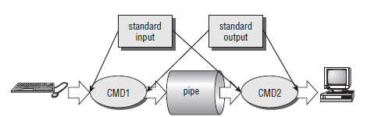
Pipe
linking shell commands together so that the output of one process is fed straight to the input of another.
For shell commands, this is done using the pipe character to join the commands, such as cmd1 | cmd2.

Slide 27
Pipe
Pipes have two limitations.
They have been half duplex (i.e., data flows in only one direction).
Pipes can be used only between processes that have a common ancestor (parent).

Slide 28
Pipe
Pipe() is a system call that facilitates inter-process communication.
Pipe opens a virtual file, which is used for communication between parent and child.
One process can write to this "virtual file" or pipe and another related process can read from it.

Slide 29
Types of Pipe
Unnamed
  Virtual file used to send data between 2 processes.
  Unnamed pipe can only work with related process.
Named or FIFO
  Created by using mkfifo command
  It is a permanent file.
  FIFO is same to unnamed file but with a facility that it can be accessed from anywhere.

Slide 30
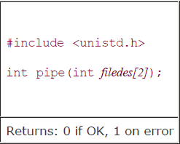
Interprocess Communication
If a process tries to read before something is written to the pipe, the process is suspended until something is written.
Syntax :

Slide 31
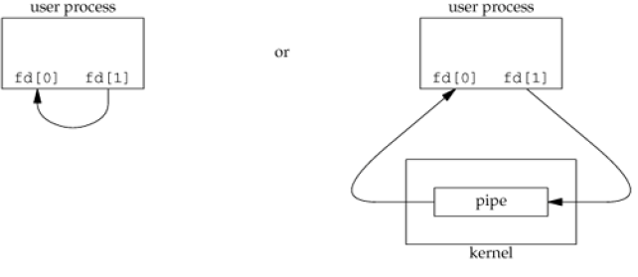
Interprocess Communication
Two file descriptors are returned through the fileds argument: fd[0] is open for reading, and fd[1] is open for writing.
The output of filedes[1] is the input for filedes[0].

Slide 32
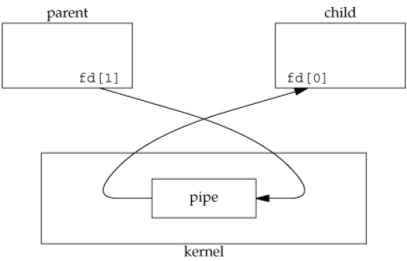
Figure : Pipe from parent to child

Slide 33
Example
pip[0] - the read end of the pipe - is a file descriptor used to read from the pipe
pip[1] - the write end of the pipe - is a file descriptor used to write to the pipe
It is possible to have a series of processes arranged in a a pipeline, with a pipe between each pair of processes in the series.

Slide 34

Popen and pclose
The simplest way of passing data between two programs is with the popen and pclose functions.
The popen function allows a program to invoke another program as a new process and either pass data to it or receive data from it.
The command string is the name of the program to run, together with any parameters. open_mode must be either “r” or “w”.

Slide 35
Popen and pclose
Flow of data is in both directions
A call to popen must specify either “r” or “w”;
When the process started with popen has finished, you can close the file stream associated with it using pclose.
The pclose call will return only when the process started with popen finishes.
If it’s still running when pclose is called, the pclose call will wait for the process to finish.

Slide 36
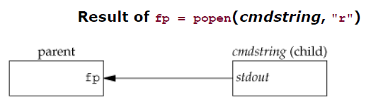
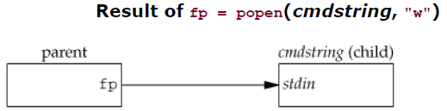
Popen and pclose
If type is "r", the file pointer is connected to the standard output of cmd string. (i.e read into)
If type is "w", the file pointer is connected to the standard input of cmd string (i.e write into)

Slide 37
Popen and pclose
popen :
Arguments :
1. command that will be executed by the child process.
2. The type of communication by the parent, i.e. whether the parent is going to read from the pipe or write into the pipe.
Return : It returns a file descriptor that gets created as a result of call to the pipe.
rd=popen("ls","r");

Slide 38
FIFOs (Named Pipes)
FIFOs are sometimes called named pipes.
if two unrelated processes want to be able to exchange data?
We do this using FIFOs.

Slide 39
FIFOs
One of the major disadvantage of pipes is that the they can not be accessed using their names by any other process other than child and the parent.
The work around for this problem is to create a named pipe which is also called as a FIFO, which stands for First in First out, meaning the data that is written into the pipe first will be read out first always.
fifo are created using the function mkfifo()

Slide 40
FIFOs
Once the file is created, it needs to be opened using the system call open()
the data can be read and written from the file using read() and write system calls.
Another advantage of a fifo over the pipes is that fifo are bidirectional, that is the same fifo can be read from as well and written into.

Slide 41
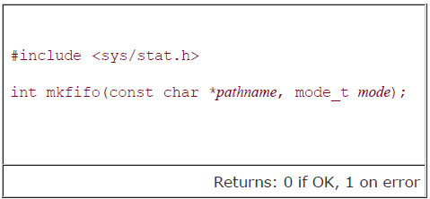
FIFOs
One of the examples you can think of using a named pipe is communication between a server and a client.
There are two fifos one of the server and the other of the client, then the client can send request to the server on the server fifo which the server will read and respond back with the reply on the client's fifo.

Slide 42
Un-named Pipe with popen() and pclose()
1. Write into a pipe
Syntax: File pointer = popen(“process”, “mode”);
rd=popen("wc -c","w");
fwrite(buffer,sizeof(char),strlen(buffer),rd);
2. Read from file
rd=popen("ls","r");
fread(buffer, 1, 50, rd);
3. Close file after reading or writing
pclose(rd);

Slide 43
Named Pipe
1. Create a file
  int res;
  res = mkfifo("fifo1",0777);
  2. Write into named pipe
res=open("fifo1",O_WRONLY);
write(res,"written",7);
3. Read from a named pipe
res=open("fifo1",O_RDONLY);
n=read(res,buffer,100);

